Slide 1
Learning Outcomes
Learn OOP Concepts
Learn OOP Principles
Know how the OOP Principles affect Class design

Slide 2
Object Oriented Design and Principles

Slide 3
Why OOD Principles and Patterns
Software development specifications keep changing constantly.
software solves real life problems and processes in real life (and your knowledge) evolve
Software need to be smart enough to cope
Easy to maintain (by applying changes with minimal effort) !
Easy to extend (without changing existing code)

Slide 4

OOP Concepts
Abstraction
"Denotes the essential characteristics of an object that distinguish it from all other kinds of objects and thus provide crisply defined conceptual boundaries, relative to the perspective of the viewer
Concentrating only on essential characteristics
Encapsulation
"Process of compartmentalizing the elements of an abstraction that constitute its structure and behaviour
Encapsulation serves to separate the contractual interface of an abstraction and its implementation

Slide 5
OOP Concepts
Modularity
"Modularity is the property of a system that has been decomposed into a set of cohesive and loosely coupled modules (classes).
Cohesive: Performing a single type of tasks
Loosely coupled: Highly independent
Data Abstraction
"Creating new data types that are well suited to an application; allows the creation of user defined data types, having the properties of build in data types and a set of permitted operators
"Abstract Data Type: A structure that contains both, data and the definition of actions to be performed with that data.

Slide 6
OOP Concepts
Inheritance
"Inheritance defines implementation of a class in terms of another's
New data types can be defined as extensions to previously defined types " This allows reuse since the implementation is not repeated.
Polymorphism
"Polymorphism through method overloading (design time polymorphism)
Create more than one function with same name but different signature
"Polymorphism through method overriding (run time polymorphism.)
Create a function in the derived class with the same name and signature

Slide 7
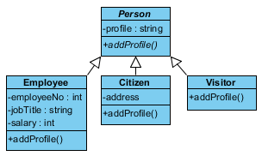
Abstract vs Concrete Classes
Abstract class
A class that cannot be directly instantiated
An abstract class is written with the expectation that its concrete subclasses will add to its structure and behaviour.
Concrete class
A class that can be directly instantiated
A class whose implementation is complete and thus may have instances

Slide 8
Interfaces
An interface describes the behavior or capabilities of a class without committing to a particular implementation of that class
An interface is a contract of related services and a set of conditions that must be true for the contract to be faithfully executed
Interfaces formalise polymorphism, they allow us to define polymorphism in a declarative way unrelated to implementation

Slide 9
Design Principles of a Class(SOLID)
Software solves real life business problems and real-life business processes evolve and change - always.
A smartly designed software can adjust changes easily; it can be extended, and it is re-usable.
SOLID Principles (by Uncle Bob)*
S = Single Responsibility Principle
O = Open-Closed Principle
L = Liscov's Substitution Principle
I = Interface Segregation Principle
D = Dependency Inversion Principle
*[http://butunclebob.com/ArticleS.UncleBob.PrinciplesOfOod]

Slide 10
Single Responsibility Principle
A class should have one and only one responsibility
Code becomes coupled if classes have more than one responsibility
Modifications done carry the risk of affecting other parts of the class
Classes with more than one responsibility need to be split up.
Benefits:
Supports reuse
Supports modifying minimal amount of code
A method should have one and only one responsibility
Methods should be broken down so that they do only one job
Benefits:
Supports reuse
Supports modifying minimal amount of code

Slide 11
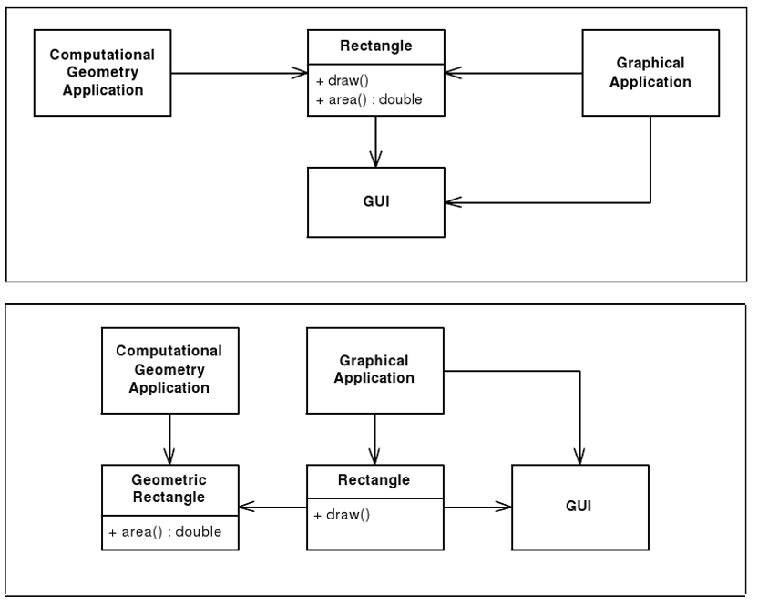
Single Responsibility Principle- Example
Bad Design
Good Design

Slide 12
Open-Closed Principle
Software entities (classes, modules, functions, etc.) should be open for extension, but closed for modification."
Open for Extension means:
The behavior of the module can be extended. That we can make the module behave in new and different ways as the requirements of the application change, or to meet the needs of new applications.
Closed for Modification means
The source code of such a module is inviolate. No one is allowed to make source code changes to it.

Slide 13
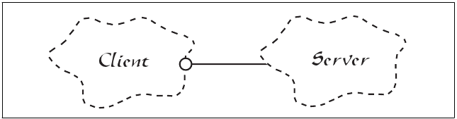
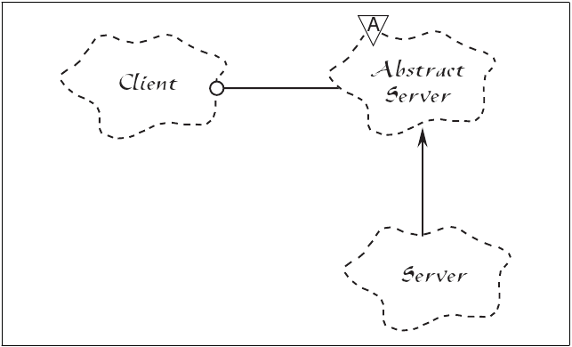
Open-Closed Principle
We can’t keep changing the server code to satisfy client needs
Bad Design
Good Design
Create an abstract server then extend as many servers as you need

Slide 14
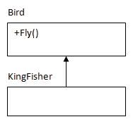
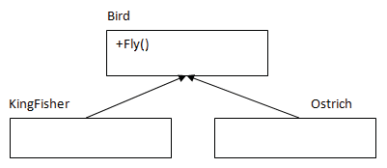
Liskov's Substitution Principle
Subtypes must be substitutable for their base types
Methods that use references to base classes must be able to use objects of derived classes without knowing it. In other words, objects of a superclass shall be replaceable with objects of its subclasses without breaking the application.
The "is a" technique of determining inheritance relationships is simple and useful, but occasionally results in bad use of inheritance
This is just a way of ensuring that "inheritance" is used correctly
Wrong use of inheritance
There should be a separate class for birds that can't really fly and Ostrich should inherit that.

Slide 15
Interface Segregation Principle
“Clients should not be forced to depend to implement all the methods; fat interfaces upon interfaces that they do not use."
" If a class wants to implement the interface it has should be broken down
The principle ensures that interfaces are developed so that each of them have their own responsibility and thus they are specific, easily understandable and reusable

Slide 16
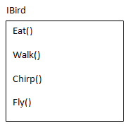
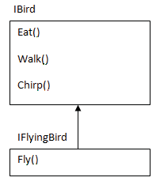
Interface Segregation Principle-Example
Interface or Abstract Class
Bad design
Good design

